Slide 1
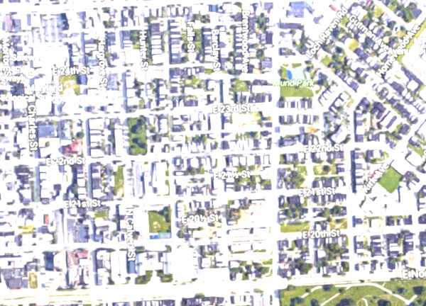
Crime&Distance
Shayna Rose
Cohort 9
Data Science
Notes:
Talk about background, why

Slide 2
Purpose
Relationship between crime and green spaces
Function of:
Distance from park
Crime type

Slide 3
Data
Baltimore City open data
2015 victim-based crime csv
Columns:
date, time, code, location, description, weapon, post, district, neighborhood, location coordinates, total incidents

Slide 4
Data Cont.
18 official parks in Baltimore
Perimeter coordinates
Google Maps
....not ideal

Slide 5
Data Frame
New column
Euclidean distance function
Iterate function across park coordinates df
Report minimum

Slide 6
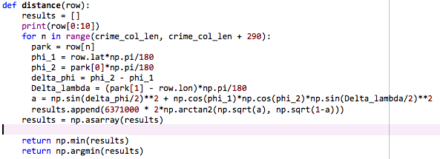

Slide 7

14,604 rows, 6 columns

Slide 8
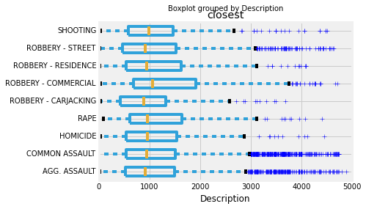

Slide 9
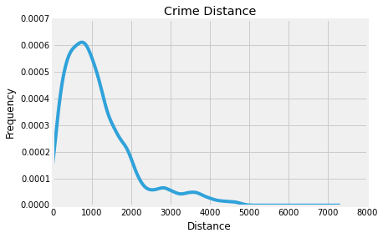

Slide 10
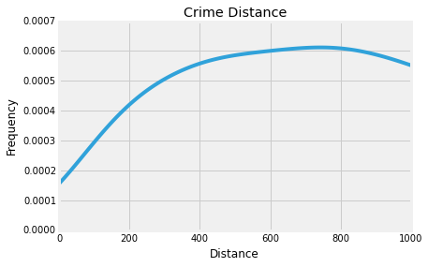

Slide 11
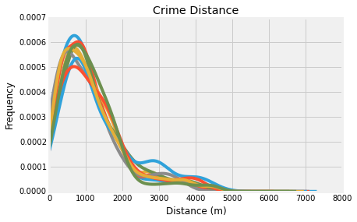

Slide 12
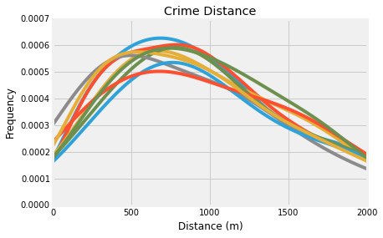

Slide 13
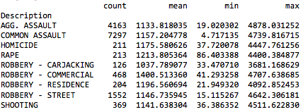
Next
Create new data frame, ordered by distance
Max is 5000 m

Slide 14
Next Cont.
Create column for crime occurrence- binary
KNN
Probability

